Slide 1
Path and Sorting Visualizer
Aesha Mahida (34)
Isha Kule (31)
Sanskruti Sankhe (57)

Slide 2
Introduction
🠶 When we talk about complex subject topics like Algorithms, it becomes extremely necessary for students to have a strong grip over the topic as it would form the foundation of their computational thinking and
programming skills.
🠶 We had observed that through conventional methods of teaching it
becomes a little difficult for students to understand the concept and also for teachers to explain their thoughts.
🠶 Motivated by the age-old saying, “a picture speaks more than thousand words”, many researchers and educators assume that students would learn an algorithm faster and more thoroughly using algorithm visualization techniques
🠶 So, we developed a method of learning through visualization and hand-on experience over different searching and sorting algorithms which is bound to help the students and teachers

Slide 3
Problem Statement
🠶 “An algorithm must be seen to be believed.” are the famous words said by Donald Knuth, a computer scientist.
🠶 Just like that, with the help of this project we are trying to do the same.
🠶 This tool can help beginners and even experienced programmers to
visualize algorithms in a better manner.
🠶 So we are going to make an interactive UI to visualize few of the most popular sorting and path finding algorithms.

Slide 4
Abstract
🠶 As a beginner’s step to algorithms and their implementation, this project demonstrates how the path finding & sorting algorithm works.
🠶 In the present work we have tried to develop a path finding & sorting visualizer using the technologies like HTML, CSS, JavaScript and Reactjs.
🠶 Dijkstra algorithm, Greedy, Best first search, Swarm search, Breadth first search, and depth first search are some of the most popular path finding algorithms today.
🠶 Sorting visualizer will be displaying the working mechanism of various sorting algorithms like Bubble sort, selection sort, insertion sort, quick sort, heap sort and merge sort.
🠶 The main objective of developing this visualizer is to make a learner
comfortable in learning these techniques quickly and easily.

Slide 5
Objectives
🠶 The goal of this project is to create a web based e-learning tool, which can be used to visualize shortest path and sorting algorithms.
🠶 Students as well as experienced people can sharpen their skills using this tool.
🠶 Designed and a comfortable UI with many cool features.
🠶 This tool introduces to a more mindful way to learn these data structures concept rather than a theoretical way of learning.
🠶 User is allowed to choose the type of obstacles according to their will with the algorithm to function between the source and the destination.

Slide 6
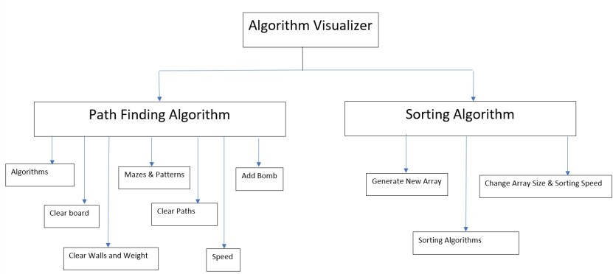
Working

Slide 7
Algorithms/Technology Stack
🠶 Sorting Algorithms:
Bubble Sort
Selection Sort
Insertion Sort
Quick Sort
Heap Sort
Merge Sort.
🠶 Searching Algorithms:
Dijkstra algorithm
Greedy Best-first Search
Swarm Search
Breadth-first
Depth-first
🠶 Technology Stack:
React
HTML, CSS, JavaScript
Bootstrap
Visual Studio Code

Slide 8
Literature Survey

Slide 9
Development of Tool for Visualizing Pathfinding Algorithms
🠶 Dr. Simmi Dutta, 30 July 2021
The development of this project has been carved out in 6 phases. These phases include all the steps of the project, beginning from data collection and processing to output for the user.
The 6 phases are:
Building of the graph matrix.
Adding walls and event listeners.
Embed the graph algorithms.
Integrate the pathfinding functionality.
Improve the design and UI.
Added the timer functionality.
After all these phases the project is completely ready for the user to use. a pathfinding visualizer that was implemented and created using entirely open source off the shelf software. By making this particular project we made it easy to understand and learn about the algorithms.

Slide 10
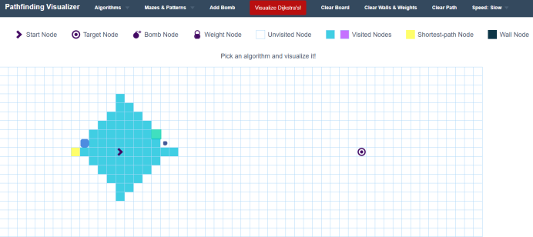
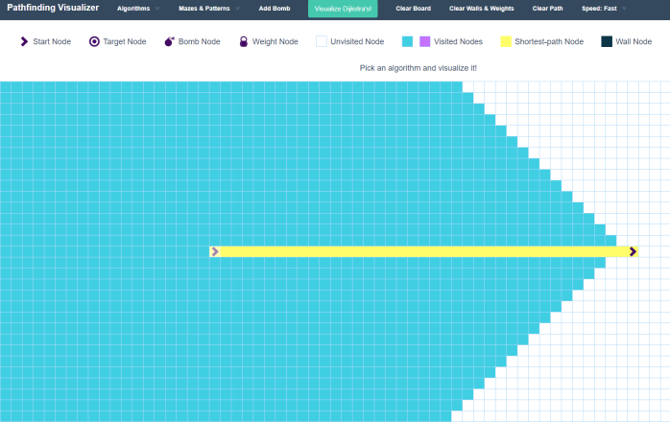

Slide 11
Development of Sorting Visualizer
🠶 Dr. A. Vijay Kumar
Visualization techniques are generally used for the graphical representation or presentation of data or information.
This visualizations or simulations produce lot of files that contains data values. Data
are converted into visual form so that it can be analyzed to solve the problems.
By using Visualizer we can create new array, choose the size of the array, speed. The speed and size of the array are divided into 5 ranges.
The speed of the visualization is directly depends upon the size of the array. The size of the array directly determines width and block size.
The sorting process majorly depends upon the sorting algorithm used, array size, so the time taken to visualize the sorting process may also change. In the present work.
When we choose generate new array, a new array with some random size is created using Math.random() and array is visualized in the form of a bar graphs.

Slide 12
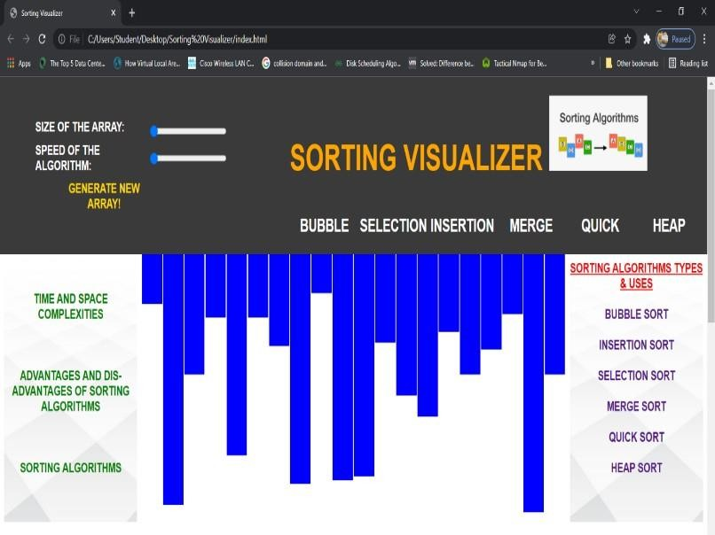
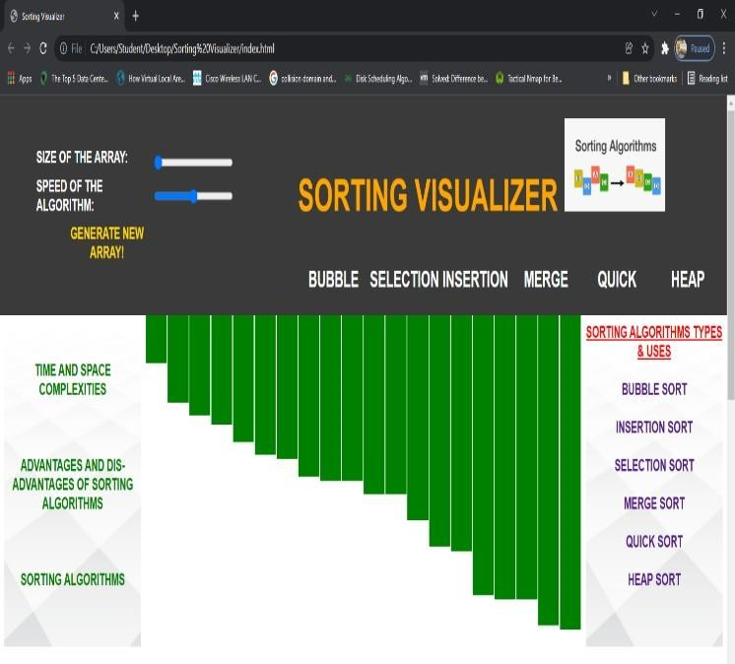

Slide 13
References
https://www.geeksforgeeks.org/dijkstras-shortest-path-algorithm-greedy-algo-7/
https://www.geeksforgeeks.org/a-search-algorithm/
https://www.w3schools.com/js/default.asp
B. Miller, D. Ranum. 2013. Problem Solving with Algorithms and Data Structures.
https://www.meta-chart.com/histogram

Slide 14
THANK YOU

